Slide 1
Docker Compose deploy via Gitlab
By Mikhitoriants Ihor
Bohomaz Viktoria
Ershov Oleh
Mentors:
Alexandr Pyura
Serhii Poletykin

Slide 2
AGENDA
SUMMARY
DECISION DRIVERS
TECHNOLOGY STACK
ENVIRONMENT DIAGRAM
DEPLOYMENT VIEW
SCHEMA DB
TASK DECOMPOSITION
QUESTIONS
REFERENCES

Slide 3
SUMMARY
Connect Container Registry for publishing Docker images.
Prepare a Java sample application for deployment into Docker Container.
Use Docker-compose for deployment infrastructure.

Slide 4
DECISION DRIVERS
Business goals:
Univercity App should be delivered in 3 weeks
Implement DevOps best practices
Constraints
Using Gitlab
Using containers
3 week limitation

Slide 5
TECHNOLOGY STACK
Gitlab 12.5
Debian 10.2
Backend: Java 8
RDBMS: MySQL 5.7.28
Docker 19.03.5
Nginx 1.17.6
Tomcat 9.0.30
Docker-compose 1.25.0
Docker-py 4.1.0
CPython 3.7.4
OpenSSL 1.1.0l
Vagrant 2.2.6

Slide 6
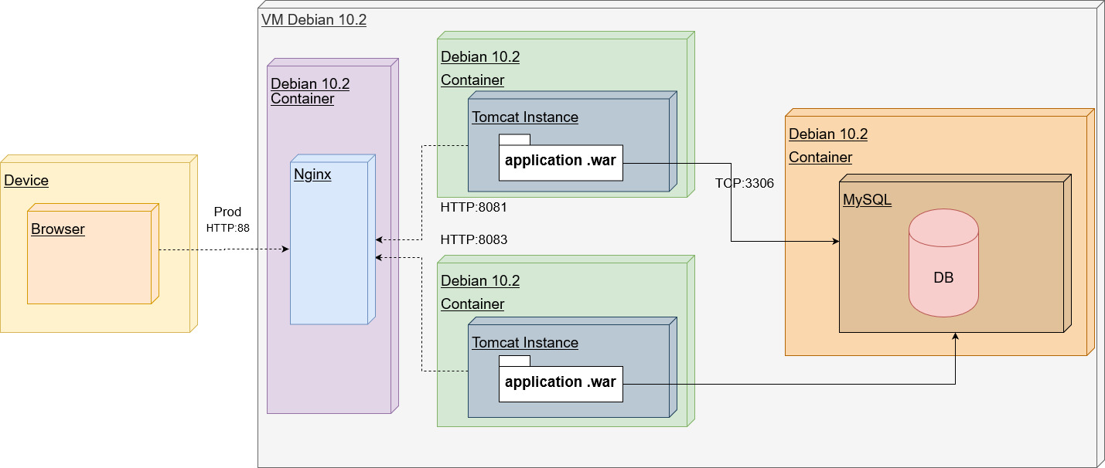
ENVIRONMENT DIAGRAM

Slide 7
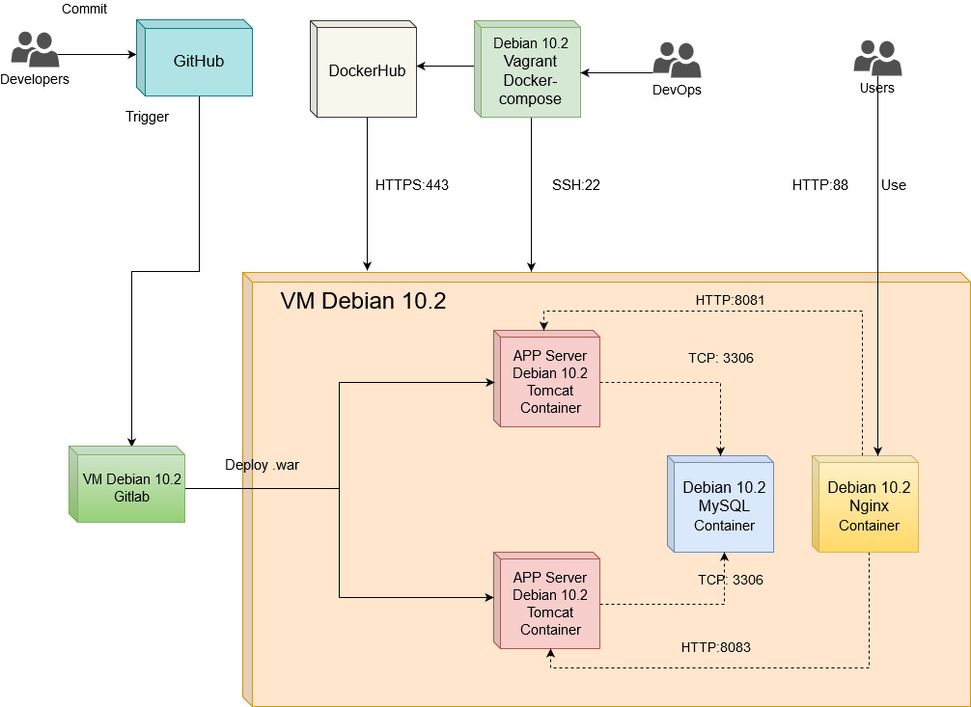
DEPLOYMENT VIEW

Slide 8
TASK DECOMPOSITION
Prepare a Java sample application with RDBMS
Create CI/CD pipeline in Gitlab
Prepare Dockerfiles for the TomCat, MySQL and Nginx containers
Upload images into Dockerhub
Prepare docker-compose.yml for the deployment infrastructure
Run pipeline
Run deployed application

Slide 9
SCHEMA DB

Slide 10
1. STEP BY STEP GUIDE
Configuring the pipeline
Connecting Pipeline to Container Registry
Creating a 3 Dockerfiles (LB, DB, Web)
Configuring the Docker-compose deployment
Running the pipeline
Open the site URL in a browser

Slide 11
QUESTIONS?

Slide 12
REFERENCES
https://github.com/Pazzl/UniversityJava
https://docs.docker.com/
https://docs.gitlab.com/
https://github.com/sameersbn/docker-mysql

