Slide 1
First demo CI/CD with Jenkins and Vmware ESXi
By : Mentors:
Alexander Krupskiy Serhii Poletykin
Oleh Ershov Alexandr Pyura

Slide 2
AGENDA
DECISION DRIVERS
TECHNOLOGY STACK
DEPLOYMENT VIEW
ENVIRONMENT DIAGRAM
QUESTIONS
REFERENCES

Slide 3
DECISION DRIVERS
Business goals
Sample of Shopping System should be delivered in 4 weeks
Support online access for customers and data managers
Implement DevOps best practices
Constraints
Java 8
CI/CD service – Jenkins
Environment - Prod
Virtual provider – Vmware ESXi
Automate with Vagrant & Ansible

Slide 4
TECHNOLOGY STACK
DEV
CI/CD: Jenkins 2.207
Repository: git
Java 8
Nginx 1.14
RDBMS: MySQL 5.7.16
ENV
Vmware ESXi 6.x
Ubuntu 18.04
Vagrant 2.2.6
Ansible 2.9.1

Slide 5
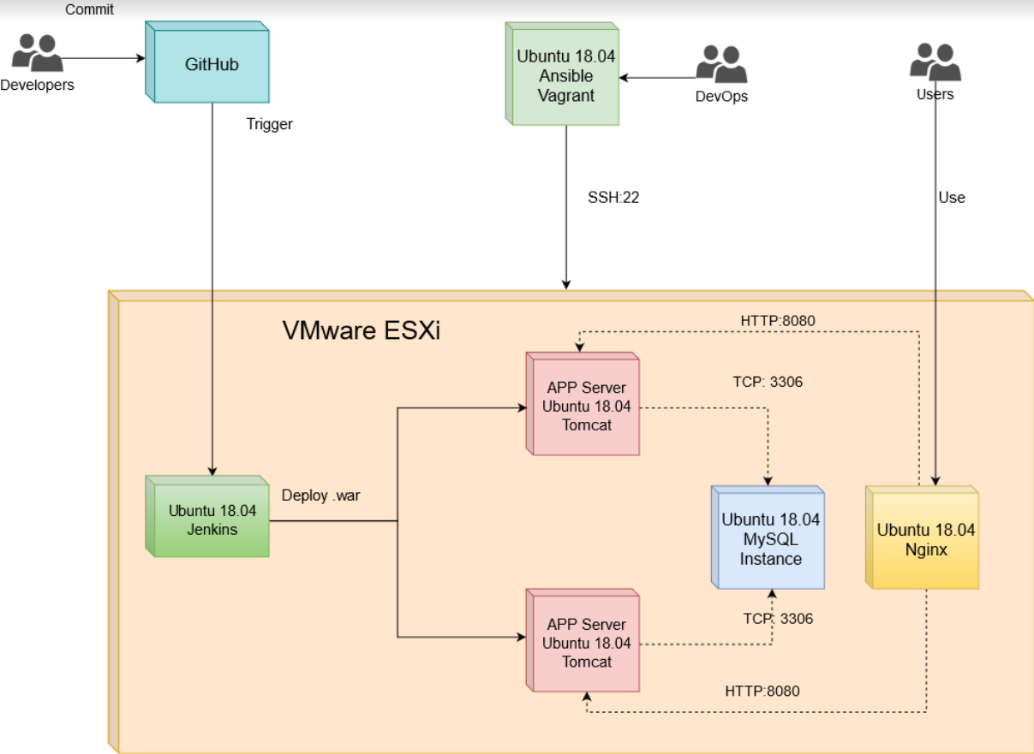
DEPLOYMENT DIAGRAM

Slide 6
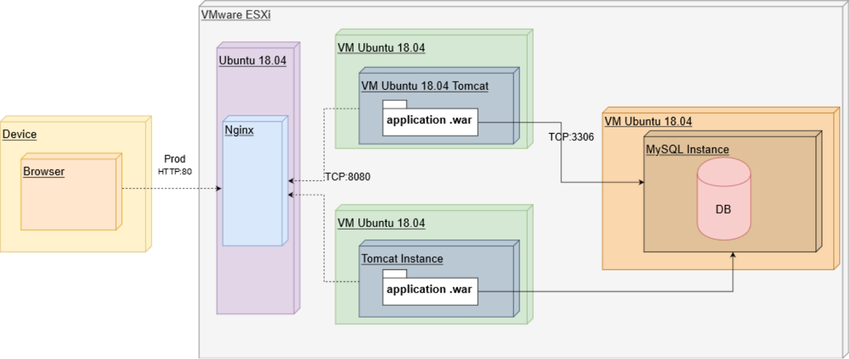
ENVIRONMENT SCHEMA

Slide 7
QUESTIONS?

Slide 8
REFERENCES
https://github.com/Pazzl/VagrantAnsible
https://docs.ansible.com/
https://www.vagrantup.com/docs/index.html
https://jenkins.io/doc/

