Slide 1
Final demo
CI/CD with Terraform and GCP
By Mikhitoriants Ihor
Ershov Oleh
Mentors:
Alexandr Pyura
Serhii Poletykin

Slide 2
AGENDA
SUMMARY
DECISION DRIVERS
TECHNOLOGY STACK
ENVIRONMENT DIAGRAM
DEPLOYMENT VIEW
SCHEMA DB
TASK DECOMPOSITION
QUESTIONS
REFERENCES

Slide 3
SUMMARY
Use Gitlab CI for build application.
Use Instance Group for autoscaling.
Use Cloud Load Balancer.
Use Cloud SQL
Prepare a Java sample application for deployment into GCP.
Use docker containers for web servers
Use Terraform for deployment infrastructure and application.
Use ELK and SmokePing for monitoring.

Slide 4
DECISION DRIVERS
Business goals:
Univercity App should be delivered in 3 weeks
Implement DevOps best practices
Constraints
Using Gitlab
Using GCP
Use Cloud LB
Use Cloud SQL
Use Terraform
Use ELK
3 week limitation

Slide 5
TECHNOLOGY STACK
Gitlab 12.5
Container-Optimized OS
Backend: Java 8
RDBMS: MySQL 5.6
Tomcat 9.0.30
Terraform 0.12
ELK 7.5.2
FileBeat 7.5.2
SmokePing 2.6.11

Slide 6
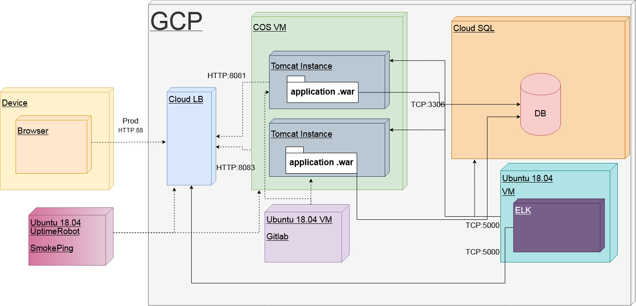
ENVIRONMENT DIAGRAM

Slide 7
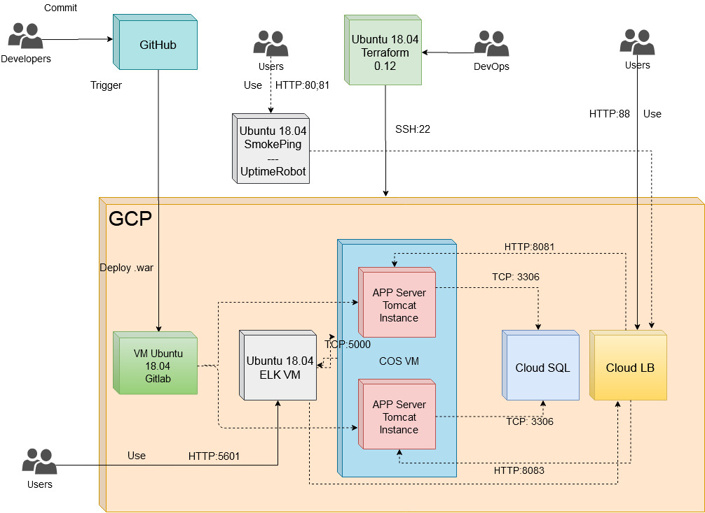
DEPLOYMENT VIEW

Slide 8
TASK DECOMPOSITION
Prepare a Java sample application with RDBMS
Create CI/CD pipeline in Gitlab
Prepare containers for the TomCats
Deployment via Terraform
Run pipeline
Run deployed application

Slide 9
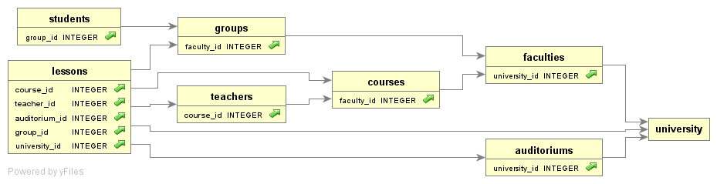
SCHEMA DB

Slide 10
1. STEP BY STEP GUIDE
Configuring the pipeline
Creating a VMs on GCP
Creating external monitoring
Creating Cloud LB, Cloud SQL instance
Configuring the Terraform deployment
Running the pipeline
Open the site URL in a browser

Slide 11
QUESTIONS?

Slide 12
REFERENCES
https://github.com/Pazzl/UniversityJava
https://docs.gitlab.com/
https://www.elastic.co/guide/index.html
https://oss.oetiker.ch/smokeping/doc/index.en.html
https://uptimerobot.com

